Slide 1
Lecture 4d: Addressing Modes
To watch lecture video click link below
Lecture 4d video
Correction: in video Lecture 3d should be Lecture 4d
To view slides, continue to next slide

Slide 2
Lecture 4d: Addressing Modes

Slide 3
MIPS Addressing Modes
MIPS Features
Load-store (register-register) architecture
Simple addressing mode
Five Addressing Modes
Immediate addressing (e.g. addi)
Register addressing (e.g. add)
Base addressing (e.g. lw, sw)
PC-relative addressing (e.g. beq)
Pseudo-direct addressing (e.g. j)

Slide 4
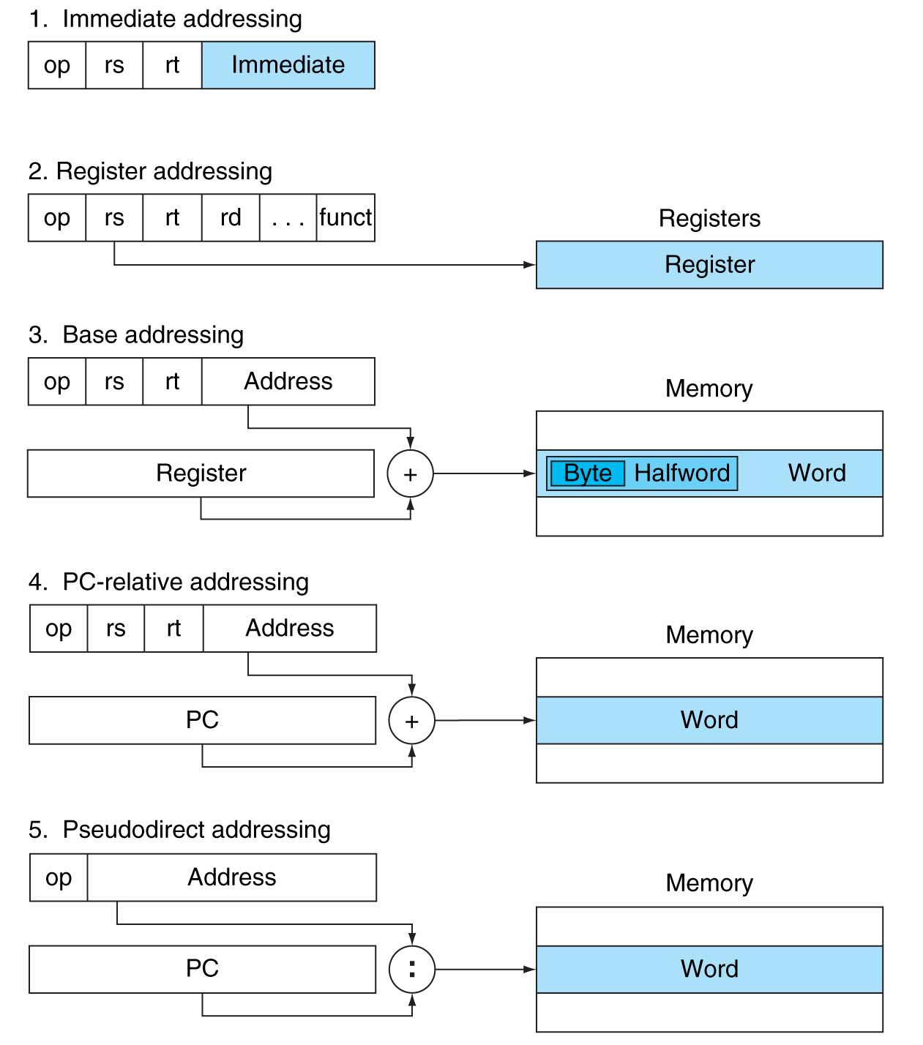
Illustration of Addressing Modes
Errata: ”address” should be “offset”
Figure 2.10.1

Slide 5
Immediate Addressing
Immediate Addressing
Data/Operand stored in the instruction, immediately available.
Example: addi R8, R16, 5
I-type instruction
The sum of Register 16 content and (sign-extended) immediate value 5 will be stored in R8
Here the 2nd operand (i.e. value 5) is stored in the instruction directly as immediate value => Immediate addressing for this operand.
000100
(opcode)
10000
(R16)
01000
(R8)
0000 0000 0000 0101
(value 5 in 16 bits)

Slide 6
Register Addressing
Register Addressing
Data/Operand stored in the register
Register number is available in the instruction
Example
add R8, R16, R17
000000
(opcode)
10000
(R16)
10001
(R17)
01000
(R8)
00000
(shamt)
100000
(funct)
32-bit value
R16
R17

Slide 7
Base Addressing
Base Addressing
Data/Operand stored in the memory
Memory address is calculated by adding the content of a base register with an offset value
The # of base register is available in the instruction
The offset value is also available in the instruction
Example
lw R8, 0x0020 (R16)
i.e. $t0 = A[8], with A’s starting address in R16

Slide 8
Base Addressing: Illustration
10000
(R16)
01000
(R8)
0000 0000 0010 0000
(0x0020 16-bit)
lw
SignExt
R16’s content (32-bit)
0x 0000 0020 (32-bit)
+
Memory

Slide 9
PC-Relative Addressing
PC-relative addressing
The next PC is relative to the current PC
i.e. Next PC is PC + offset
Data to be fetched: the next instruction stored in memory
Example
beq R16, R17, 0x0020 #offset: 0x0020, i.e. 32
Assume current PC: FFFF0000
offset*: 0x0020
Next PC: FFFF0020
*in case word offset is used, we need to convert to byte offset (i.e. offset is 32 words, which meant 32*4 = 128 bytes.) We will discuss Module 6.

Slide 10
Pseudo-Direct Addressing
Pseudo-Direct Addressing
For the J (jump) instruction, the next PC address should be in the instruction.
Example: J Exit
Here Exit is the next instruction’s PC.
However, PC has 32 bits, can’t fit into the whole instruction, so partial address is used.
Details omitted here.
Opcode (6 bits) | Address (26 bits)

Slide 11
RISC Architecture
RISC: Reduced Instruction Set Computer
Developed in 1980s
Prior to RISC, CISC Architecture popular
CISC: Complex Instruction Set Architecture
MIPS is a RISC architecture
Features of RISC
Simple instruction format (e.g. in MIPS only R, I, and J)
Only loads/stores reference memory (load-store architecture)
Highly pipelined (to be discussed in Module 7)
Instructions executed by hardware (reflected in Module 6 design)
Few instructions and modes (simplicity)
Complexity in the compiler
Multiple register sets
MIPS: integer R0, … R31, floating point F0, .., F31

Slide 12
Summary
Addressing modes
RISC architecture (introduction)

